Slide 1

Image Encryption Using AES Algorithm
Team - DYNAMIC DUDES
Team - DYNAMIC DUDES
AIE19013
AIE19014
AIE19062
Charan Tej. K
CH. Surya Teja
Sugash T.M

Slide 2







STEP 02
STEP 04
STEP 06
AES Algorithm
Hiding Secret Messages in Image
Sample Output
STEP 01
STEP 03
STEP 05
STEP 07
Introduction
Image Encryption using AES
Implementation
Conclusion

Slide 3


Introduction

Slide 4


Introduction
Image encryption can be defined as the process of encoding secret image with the help of existing encryption algorithm
We know that digital images play an important role in multimedia technology, it becomes more important for the user's to maintain privacy.
In order to provide such security and privacy to the user, image encryption is very important to protect from any unauthorized user access.

Slide 5

AES Algorithm

Slide 6

AES Algorithm
AES is an iterative rather than Feistel cipher. It is based on ‘substitution–permutation network’.
It comprises of a series of linked operations, some of which involve replacing inputs by specific outputs (substitutions) and others involve shuffling bits around (permutations).
In our Project we are using AES-256 and its block size is 16 bytes and the key size is 32 bytes

Slide 7
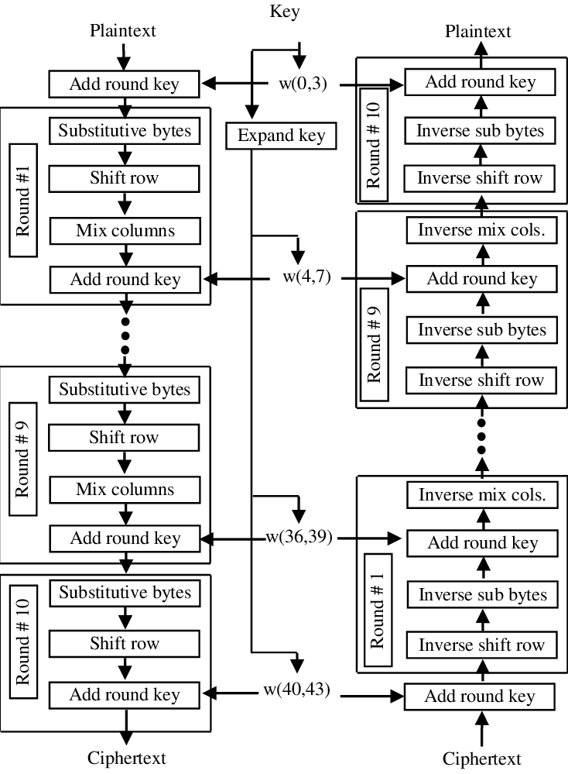
AES Algorithm
Byte Substitution
The 16 input bytes are substituted by looking up a fixed table (S-box) given in design. The result is in a matrix of four rows and four columns.
Shift Rows
Each of the four rows of the matrix is shifted to the left
Mix Columns
Each column of four bytes is now transformed using a special mathematical function. This function takes as input the four bytes of one column and outputs four completely new bytes, which replace the original column.
Add Round Key
The 16 bytes of the matrix are now considered as 256 bits and are XORed to the 256 bits of the round key. If this is the last round then the output is the ciphertext.

Slide 8
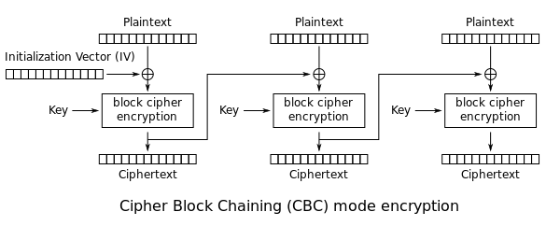
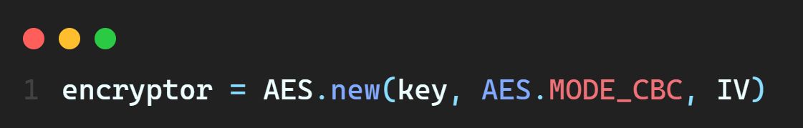
CBC Mode

Slide 9
Image Encryption Using AES

Slide 10

Image Encryption
Firstly, we considered an RGB image. Then we are directly reading it matrix form.
This whole matrix is undergoing through AES - 256 algorithm with the help of key that we will be giving as a password while executing
The above point tells us that each pixel value in matrix is being encrypted using AES – 256 algorithm.
In the decryption process we follow the same process as above but we will be passing the encrypted file as input to obtain the original image

Slide 11
Image Encryption
Encryption
RGB Image
Encrypted.enc
Decryption

Slide 12

Hiding Secret Messages

Slide 13
Steganography
Steganography is the art of hiding a message. Its main purpose is to hide a message inside an image, so that only the parties intended to get the message even knows a secret message exists
In modern computing world, for the prevention of cyber attacks, computer scientists use steganography to conceal information inside the images for communications
In our project, we have carried out steganography as an application of the previously described image encryption, in order to ensure advanced level of security

Slide 14

Methodology
Password
AES – 256
Encrypt
Secret Message
Produces
Original Image
Encoded Image

Slide 15
Methodology - Encryption
For example lets consider a message to be hidden = “Hello”
0 1 0
(113,45,201)
0 1 0
( 96, 121, 89)
0 1
(54, 189,224)
H
72
01001000
8 Bits
0 1 0
(114,45,201)
0 1 0
( 96, 121, 89)
0 1
(54, 189,224)
If the bit is 0 – change its respective pixel intensity value as even
If the bit is 1 – change its respective pixel intensity value as odd
If the last pixel intensity value is even, it conveys the message still continues, or else if it is odd, it tells that the message is terminating

Slide 16
Methodology - Decryption
As the initial step, we have to convert the binary digits to its ascii format and then to its corresponding alphabet
01001000
72
H
8 Bits
Password
Decoded Text
AES – 256
Secret Message
Encoded Image

Slide 17

Implementation

Slide 18

Implementation
Hiding Text in image
Password Verification
Retrieving the Hidden Text
$$1^{st}$$
$$2^{nd}$$
$$3^{rd}$$
$$4^{th}$$
$$5^{th}$$
Encrypting Image
Decrypting Image
18

Slide 19

Sample Output

Slide 20

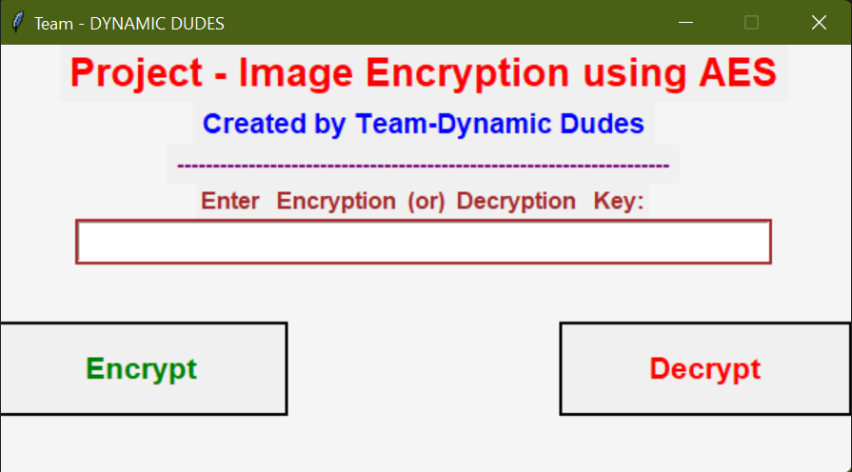
Sample code and Output

Slide 21
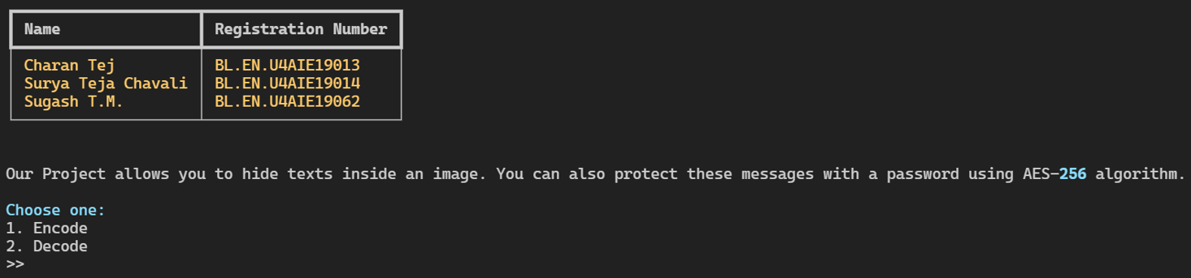
Sample code and Output

Slide 22

Conclusion
To the best of our knowledge, we have successfully implemented image encryption using AES algorithm. Later, we have also performed Steganography as an application of it
Finally, we conclude by saying that we as a team understood the importance of Applied Cryptography and its underlying principles in Image Encryption

Slide 23

☺☺☺☺☺☺☺☺☺☺☺☺☺☺☺☺☺☺☺☺
Thank You
☺☺☺☺☺☺☺☺☺☺☺☺☺☺☺☺☺☺☺☺

